Slide 1
Downscaling Air Temperature and LST Using MODIS and Landsat Data
Bill Crosson, Mohammad Al-Hamdan
Science and Technology Institute, Universities Space Research Association
National Space Science and Technology Center, Huntsville, AL
Dale Quattrochi
NASA Earth Science Office
Marshall Space Flight Center, Huntsville, AL
Dan Johnson, Austin Stanforth
Indiana University/Purdue University at Indianapolis
Maury Estes, Sue Estes
University of Alabama in Huntsville
Second Suomi NPP Applications Workshop
Huntsville, AL
18 November 2014

Slide 2
Part 1 – Downscaling re-analysis air temperature to MODIS scale
Rationale:
NLDAS (North American Land Data Assimilation System) is a meteorological re-analysis that provides hourly air temperature and other variables on a ~12 km CONUS grid for the period 1979-present. The resolution is in fact coarser since NLDAS is derived via spatial interpolation from the 32 km North American Regional Reanalysis (NARR).
At this resolution, small-scale features such as the Urban Heat Island and near-coastal temperature gradients are not captured.
We were looking for a way to down-scale NLDAS daily maximum air temperature using MODIS LST data.
Approach - use long-term means of MODIS Aqua LST (1:30 PM local time) to capture the spatial pattern of daily maximum air temperature for the summer season.

Slide 3
Downscaling method assumptions
In the absence of strong horizontal temperature advection, air temperature is driven by sensible heat flux from the surface, thus the spatial patterns of air temperature mimic the patterns of LST in a relative sense (although the magnitude of air temperature spatial variability is much lower than that of LST).
Spatial patterns of air temperature at the sub-NLDAS scale (< 12 km) are nearly constant from day to day within the respective season, as these patterns are driven mostly by land use.
Daily maximum air temperatures occur during the early-mid afternoon, aligning well with the PM Aqua and Suomi NPP overpass.
These assumptions are met much more frequently during the warm season.

Slide 4
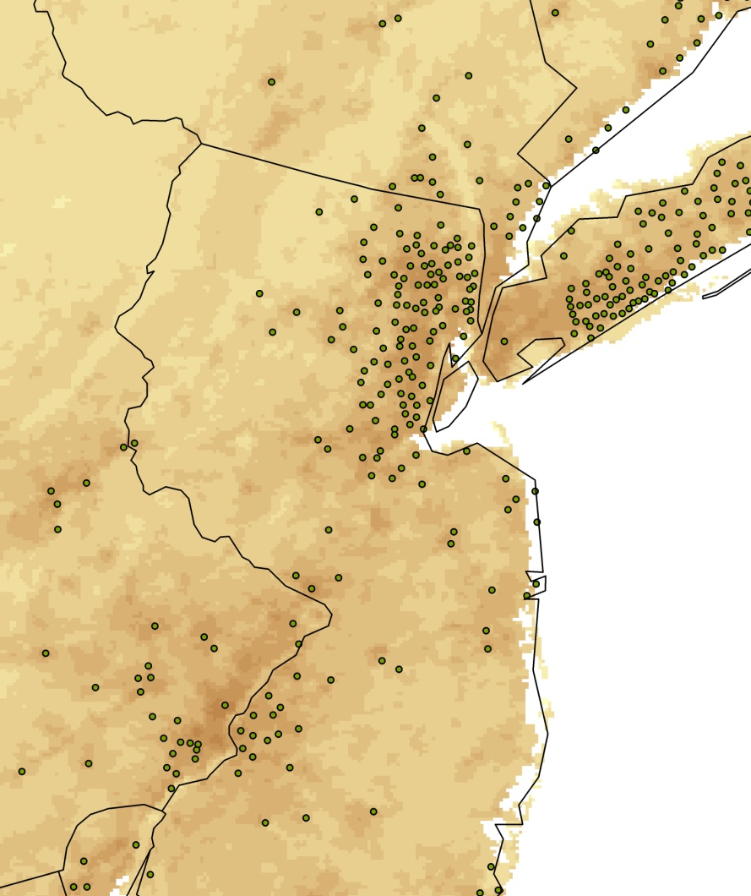
Downscaling method
1. Create summer (June – August) composite (mean of all available observations) on a 1 km grid, of daytime Aqua MODIS LST data over the period 2003-2008. This forms the basic LST spatial pattern to be used to disaggregate NLDAS summertime daily maximum air temperature.
LST (Kelvins)
Mean summer daytime Aqua MODIS LST, 2003-2008, for U.S. and for Philadelphia-New York corridor. Green circles indicate locations of cities.

Slide 5
Downscaling method
2. From the composite LST grid, calculate normalized MODIS LST departures Z_{MOD}, in which the spatial means and standard deviations are calculated within a local neighborhood or ‘moving window’, the size of which can be varied.
Z_{MOD} = (T_{MOD} – T_{MOD})/σ_{MOD}
where T_{MOD} = 1 km MODIS LST (summer composite);
T_{MOD} = mean MODIS LST over local neighborhood;
σ_{MOD} = standard deviation of MODIS LST over local neighborhood.
Normalized MODIS LST departures for St. Louis, MO area based on mean summer daytime (1:30 PM) LST. Neighborhood size = 3x3 NLDAS cells.

Slide 6
Downscaling method
3. Calculate daily maximum air temperature, the highest temperature reported for each grid cell between midnight and midnight local standard time, from NLDAS hourly data.
T (ºF)
August 13, 2007

Slide 7
Downscaling method
4. Calculate the down-scaled NLDAS maximum air temperatures for each day, T_{DIS}, based on the normalized MODIS LST departures:
T_{DIS} = T_{NLDAS} + Z_{MOD}  σ_{NLDAS}
where T_{NLDAS} = NLDAS daily maximum air temperature (12 km);
σ_{NLDAS} = standard deviation of NLDAS daily maximum air temperature over neighborhood.

Slide 8
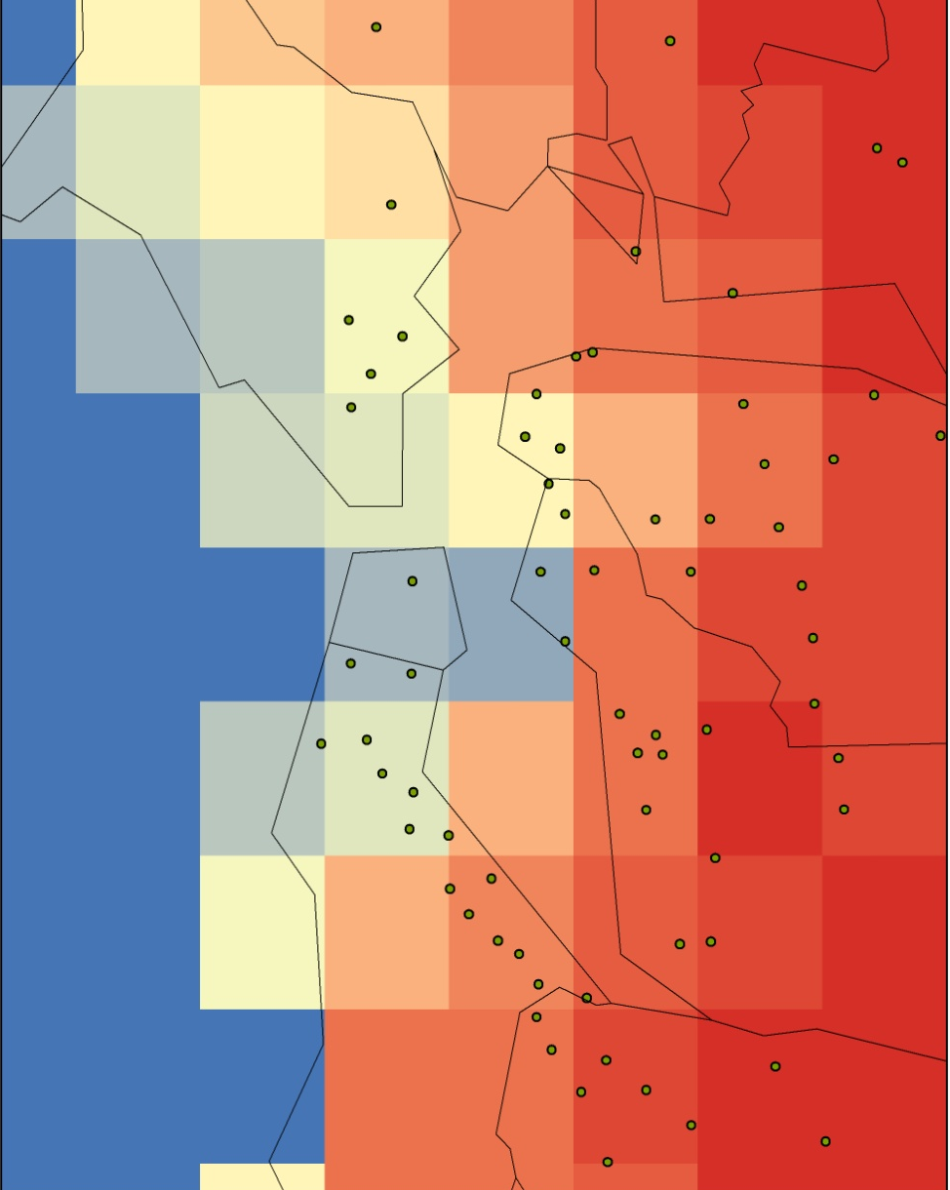
Downscaling results
12 km NLDAS temperature 1 km Disaggregated temperature
Degrees F
San Francisco Bay area
5 x 5 Neighborhood

Slide 9
Downscaling results
12 km NLDAS temperature 1 km Disaggregated temperature
Degrees F
Washington-Baltimore area
5 x 5 Neighborhood

Slide 10
Validation statistics
City | Mean Difference (deg. F) |  |  | RMSD (deg. F)
 | NLDAS | Disagg. 3x3 | Disagg. 5x5 | NLDAS | Disagg. 3x3 | Disagg. 5x5
Atlanta, GA | 3.55 | 4.33 | 4.38 | 5.16 | 5.74 | 5.79
San Francisco, CA | -7.04 | 3.51 | -0.27 | 8.52 | 6.18 | 4.80
Washington, DC | -0.83 | -1.08 | -0.78 | 2.71 | 2.77 | 2.68
Baltimore, MD | -1.64 | -1.19 | -0.71 | 3.16 | 3.03 | 2.93
St. Louis, MO | -1.63 | -1.01 | -0.86 | 3.70 | 3.52 | 3.49
Used NWS observations for 5 cities for June – August, 2009.
Comparison is between original NLDAS daily maximum air temperatures and downscaled temperatures using 3x3 and 5x5 neighborhood sizes.
Best results for each city are shown in red.
5x5 downscaling performs best in all cities except Atlanta.

Slide 11
Part 2 – Downscaling MODIS LST to Landsat scale
Rationale:
MODIS/VIIRS Land Surface Temperatures (LST) are available daily at ‘moderate’ spatial resolutions (~1 km)
Landsat thermal data are available every ~16 days at a 60 m spatial resolution
Can we take advantage of the spatial detail in Landsat data to enhance the resolution of MODIS LST?
Land Surface Temperature – July 5, 2002 – Philadelphia, PA
MODIS Landsat ETM+

Slide 12
Data and data processing
MODIS data: Aqua Level 3 LST product MYD11A1, Collection 5
LST generated used split-window algorithm
Landsat data: Landsat-5 TM and Landsat-7 ETM+
Calculation of LST from Landsat digital counts involved the following:
Convert digital count from thermal band 6 to spectral radiance
Convert spectral radiance to blackbody temperature (BBT)
Convert BBT to LST using spectral emissivity information inferred from landcover
MODIS and Landsat LST data were composited (i.e. temporal mean computed) for several cloud-free scenes collected during 2000-2007 for three cities: Philadelphia, PA; Phoenix, AZ; Dayton, OH

Slide 13
Downscaling methods
Three methods tested:
Differences (additive adjustment) – Mean (Landsat-MODIS) differences determined at Landsat scale using multiple training images and applied to case study MODIS LST image
2. Ratios (multiplicative adjustment) – Mean (Landsat/MODIS) ratios of LST determined at Landsat scale using multiple training images and applied to case study MODIS LST image
3. Normalization – Normalized departures (Z-values) calculated from Landsat training images
Similar to procedure used to downscale NLDAS air temperature

Slide 14
Downscaling results Normalization method – Philadelphia – July 5, 2002
MODIS LST (1 km)
Downscaled LST (60 m)
Actual Landsat LST (60 m)

Slide 15
Validation statistics
Downscaling Method | Phoenix, AZ | Dayton, OH | Philadelphia, PA
Differences | ME: -9.03 RMSE: 9.69 | N/A | N/A
Ratios | ME: -8.00 RMSE: 8.69 | N/A | N/A
Normalization | ME: 2.14 RMSE: 4.73 | ME: 0.45 RMSE: 4.00 | ME: 4.51 RMSE: 7.23
ME = Mean Error, RMSE = Root Mean Squared Error; errors are in degrees F.
Validation was performed for one case study image in each city.
Validation has not been performed for Dayton and Philadelphia for the Differences and Ratios methods.
Based on limited validation, Normalization seems to have best performance.

Slide 16
Downscaling results Normalization method – spatial errors for 3 cities
Phoenix
Dayton
Scheme has some problems capturing spatial patterns around distinct geographic features – rivers, mountains, etc.
Philadelphia

Slide 17
Summary and conclusions
MODIS 1 km LST has been used successfully to downscale 12 km re-analysis daily maximum air temperature, and has been down-scaled to Landsat scale (60m) using Landsat thermal data.
The downscaling scheme is fairly simple to apply.
There are many ‘variations on the theme’ in terms of how neighborhood means and standard deviations are computed. Different neighborhood sizes are better in different situations. Also, recent 8-day mean MODIS LST may be better for calculating normalized LST departures. More thorough analysis is needed.
The approach has some limitations but appears to have great utility for estimating air temperatures, with particular value in urban and coastal areas.

Slide 18
Acknowledgments
Funding for this project was provided by NASA’s Applied Sciences Program and Earth Science Division.
Thanks to Ms. Sarah Hemmings from USRA for assisting in Landsat data processing.

